Slide 1

Advancing the Use of Machine Learning in the Development of Useable Tree-Ring-Based Reconstruction of Streamflow
A Study of the Tennessee River Valley
Madi Brake, Spencer Livingston, and Mahsa Mirzakhani
Notes:
Spencer

Slide 2
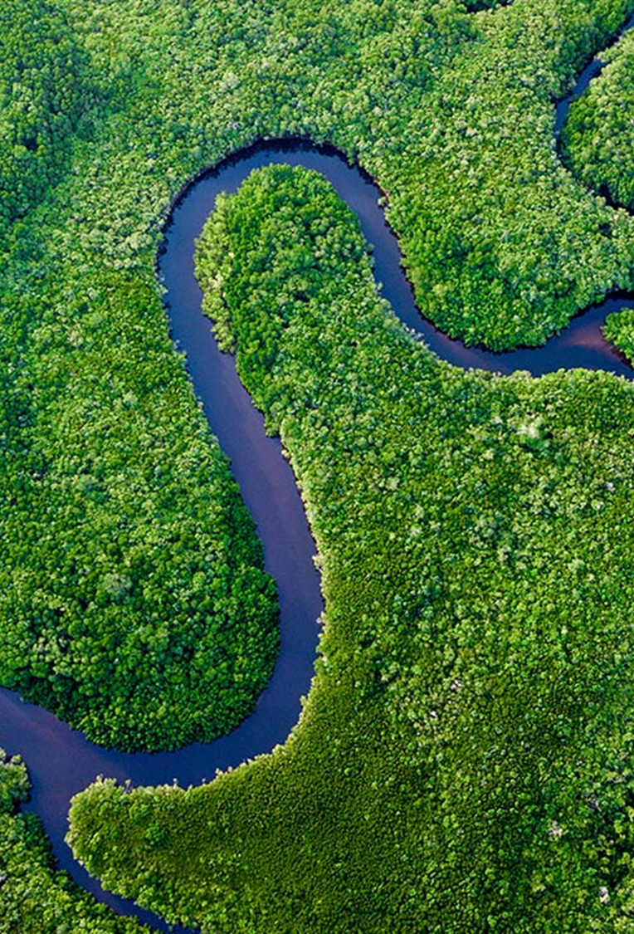
Presentation Outline
Introduction & Background
Use-Inspired Problem Statement
Material & Methods
Traditional SLR Methods
ML Methods
Evaluation & Performance Metrics
Results
Discussion
Broader Impacts
Notes:
Spencer

Slide 3
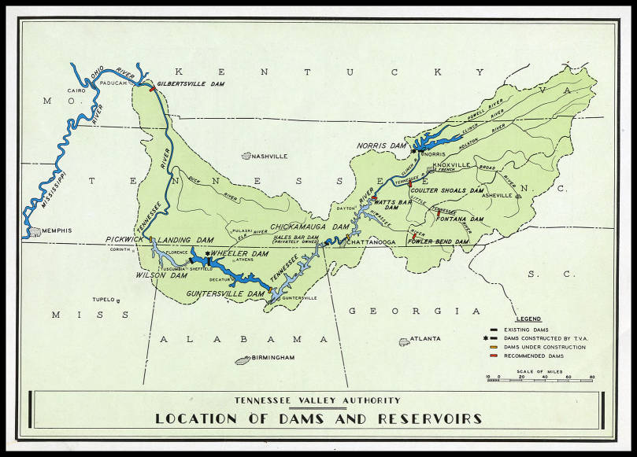
Observed streamflow data can be missing, or incomplete.
Data indicative of variation of water availability over time
Flood control and energy production sectors utilize this data
Tree Rings can be a proxy (long temporal extent) to reconstruct historical data
Dendroclimatic reconstructions place modern climatic events in a long-term context
Limited research in SE US due to limited unimpaired stream gauges (infrastructure) and limited seasonal correlation with tree rings (dry winters)
Source: Tennessee Valley Archive
Introduction
& Background
Use-Inspired Problem Statement
Material & Methods
Results
Discussion
Broader Impacts
Notes:
Madi

Slide 4
Challenges
Short streamflow records hinder long-term trend analysis and accurate reconstructions.
Advanced AI/ML techniques haven't been fully explored for streamflow reconstruction.
Goal
Extend historical streamflow records, provide past water availability information, and assist water management decisions in the Tennessee River Valley domain.
Objective
Compare AI/ML/DL models with traditional methods for streamflow reconstruction in the Tennessee Valley watershed using tree-ring based proxies.
Introduction
& Background
Use-Inspired Problem Statement
Material & Methods
Results
Discussion
Broader Impacts
Notes:
Mahsa

Slide 5
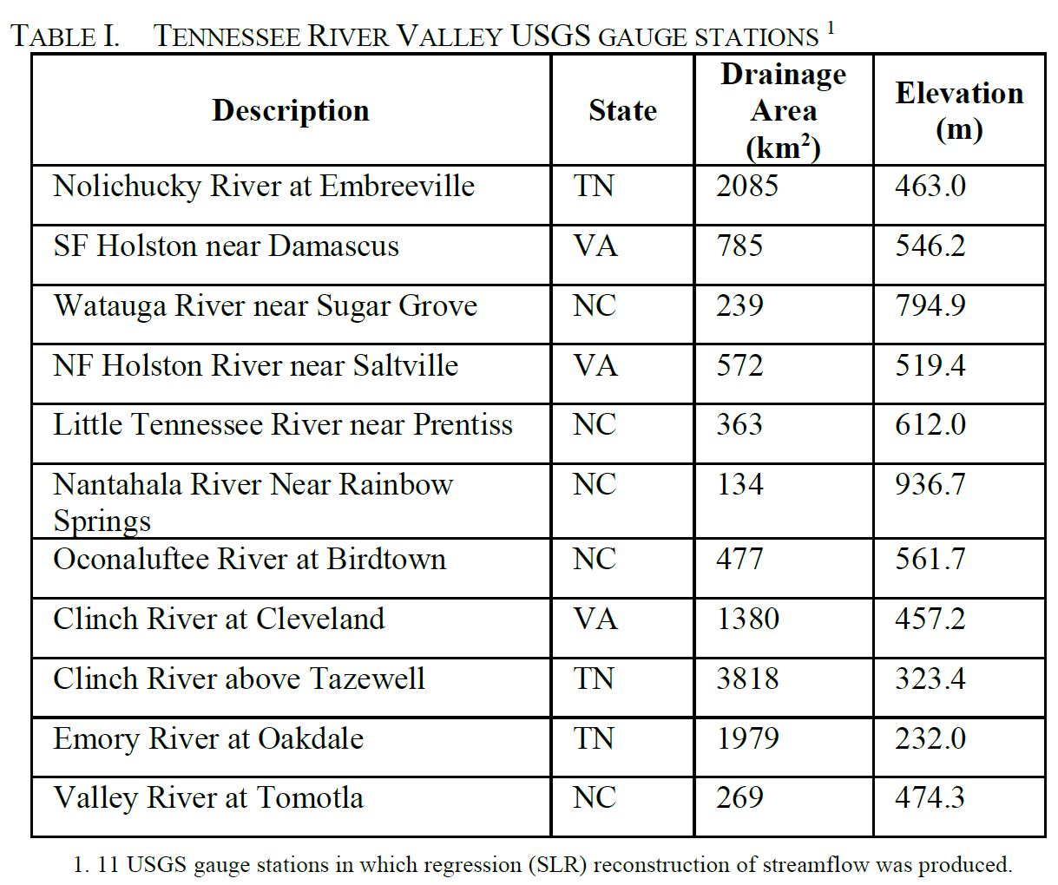
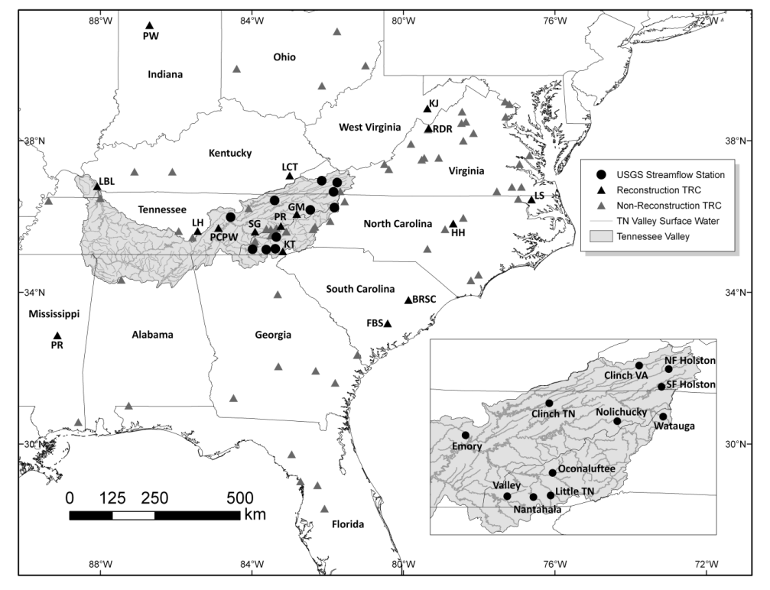
USGS Gauge Streamflow Data
Streamflow data for 11 gauges within the Tennessee Valley were obtained from USGS (Anderson et al., 2019)
For this study, only USGS gauge stations with complete and records were used (no gaps)
These stations provided monthly cumulative flow data in million cubic meters (MCM)
Seasonal volumes were computed on an annual timescale:
Summer (June-September, denoted JJAS)
Winter (December-March, denoted DJFM)
Annual (January-December, denoted annual)
Source: Anderson et al., 2019
Introduction
& Background
Use-Inspired Problem Statement
Material & Methods
Results
Discussion
Broader Impacts
Notes:
Madi

Slide 6
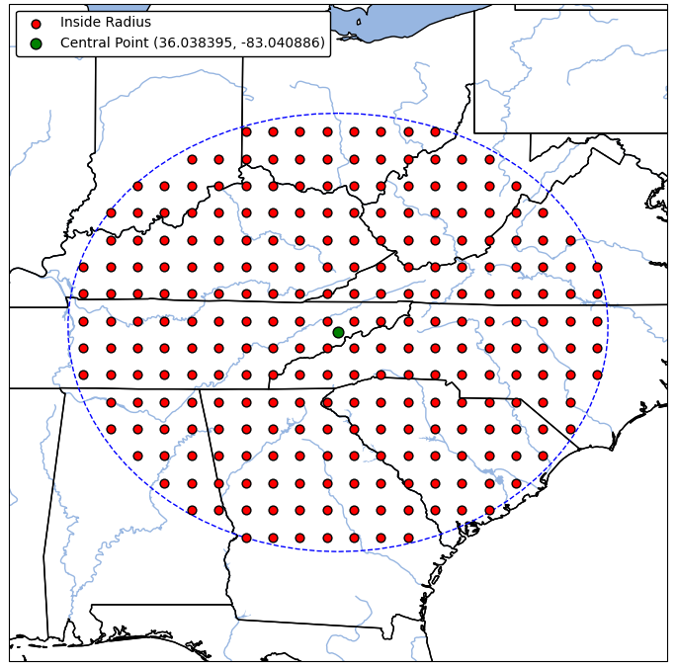
scPDSI Grid Points
NADA provides self-calibrating Palmer Drought Severity Index (scPDSI) grid points.
scPDSI values range from -4 to 4 for each year.
scPDSI points cover a 450-kilometer radius around the centroid of the studied stream gauges.
Robust temporal extent reaches back to 365 AD thanks to tree-ring chronologies.
Introduction
& Background
Use-Inspired Problem Statement
Material & Methods
Results
Discussion
Broader Impacts
Notes:
Mahsa

Slide 7
Traditional Methods
Strict Pre-screening of scPDSI Cells
Eliminate those with correlations to observed streamflow below 99%.
Ensure stable correlations throughout the overlapping period of record
Predictors and Predictand for SLR
Predictors: Pre-screened scPDSI cells (independent variables).
Predictand: Observed streamflow (dependent variable).
Stepwise Linear Regression (SLR)
Employ both forward and backward SLR techniques for reconstruction.
Bias Correction
Apply quantile mapping bias correction to each SLR-generated streamflow vector.
Introduction
& Background
Use-Inspired Problem Statement
Material & Methods
Results
Discussion
Broader Impacts
Notes:
Spencer

Slide 8
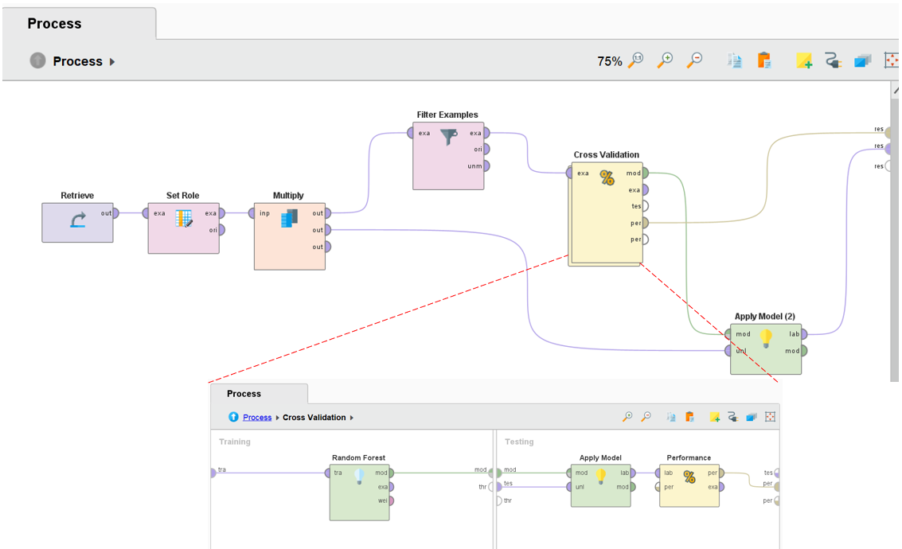
ML Methods - Models
Using the platform RapidMiner Studio, processes were developed to train and test the learning algorithms on the following data:
Observed summer streamflow (JJAS) for three of the eleven USGS gauge sites:
SF Holston
Little TN
Valley
All gridded scPDSI data within a 450-kilometer radius (249 cells)
The performance of these three ML models, RF, GLM, and DL, were evaluated using 40-, 5-, and 10-fold cross-validations, respectively.
R² and RMSE used as performance evaluation metrics
RapidMiner ML process diagram for RF, GLM, and DL streamflow reconstructions.
Introduction
& Background
Use-Inspired Problem Statement
Material & Methods
Results
Discussion
Broader Impacts
Notes:
Madi (Process / Models)

Slide 9
ML Methods - Algorithms
Our Research:
AI/ML streamflow reconstruction methods employed using the no-code platform, RapidMiner Studio.
For each gauge, the instrumental record and 450-km radius scPDSI values will be utilized for training and cross-validation.
The ML algorithms used to reconstruct streamflow at each of the 11 gauges will include:
Generalized Linear Model (GLM)
Extends regression to allow for variables to have distribution other than normal
Random Forest (RF)
Constructs multiple decision trees, splitting nodes randomly to increase diversity among trees in the model
Deep Learning (DL)
Unsupervised learning method. Uses backpropagation to propagate errors back to the input from the output to update weights of the models and minimize loss
Introduction
& Background
Use-Inspired Problem Statement
Material & Methods
Results
Discussion
Broader Impacts
Notes:
Spencer (Algorithm Background)

Slide 10
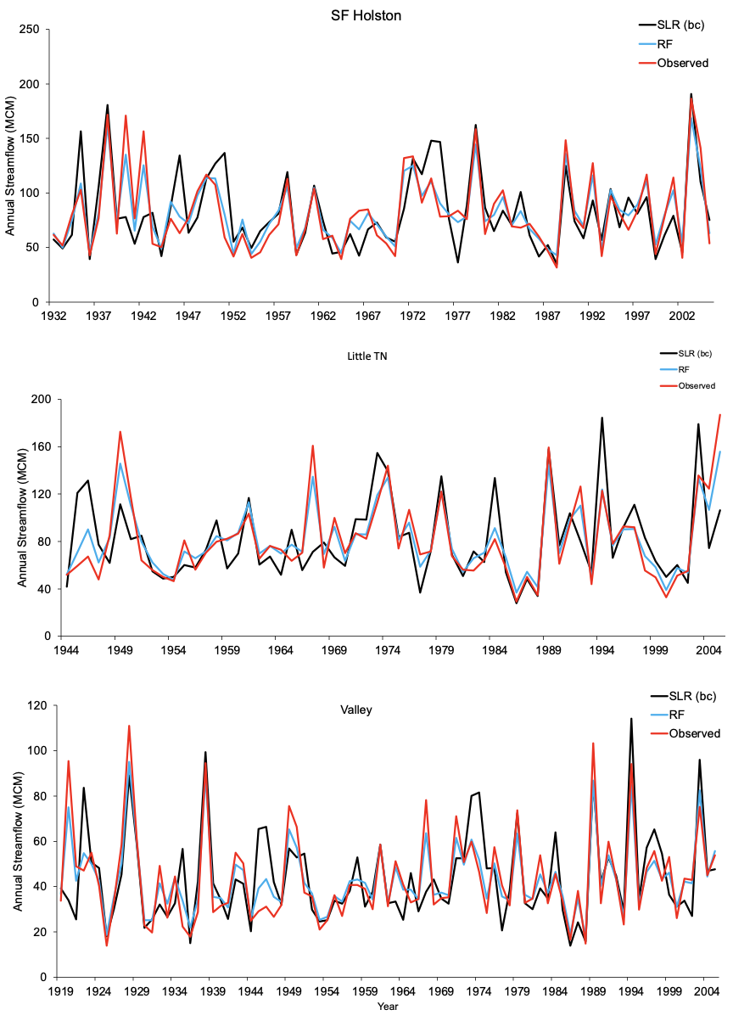
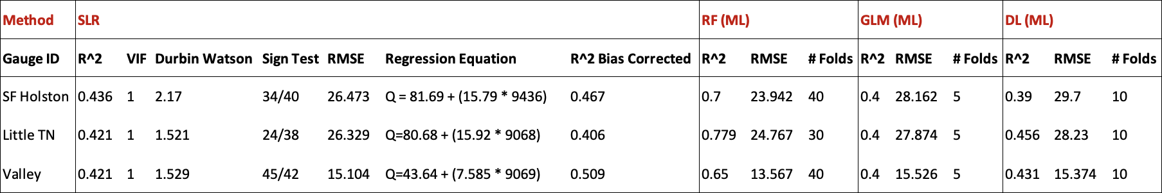
SLR vs ML Results
Table: Comparative Performance of Machine Learning Techniques Versus Stepwise Linear Regression for Streamflow Reconstruction (JJAS) Skill Statistics (365-2005 AD) in the Tennessee River Valley
Figure: JJAS streamflow reconstructions (a) SF Holston Gauge, (b) Little TN Gauge, and (c) Valley Gauge – SLR vs RF during instrumental period in the Tennessee River Valley.
Introduction
& Background
Use-Inspired Problem Statement
Material & Methods
Results
Discussion
Broader Impacts
Notes:
Mahsa

Slide 11
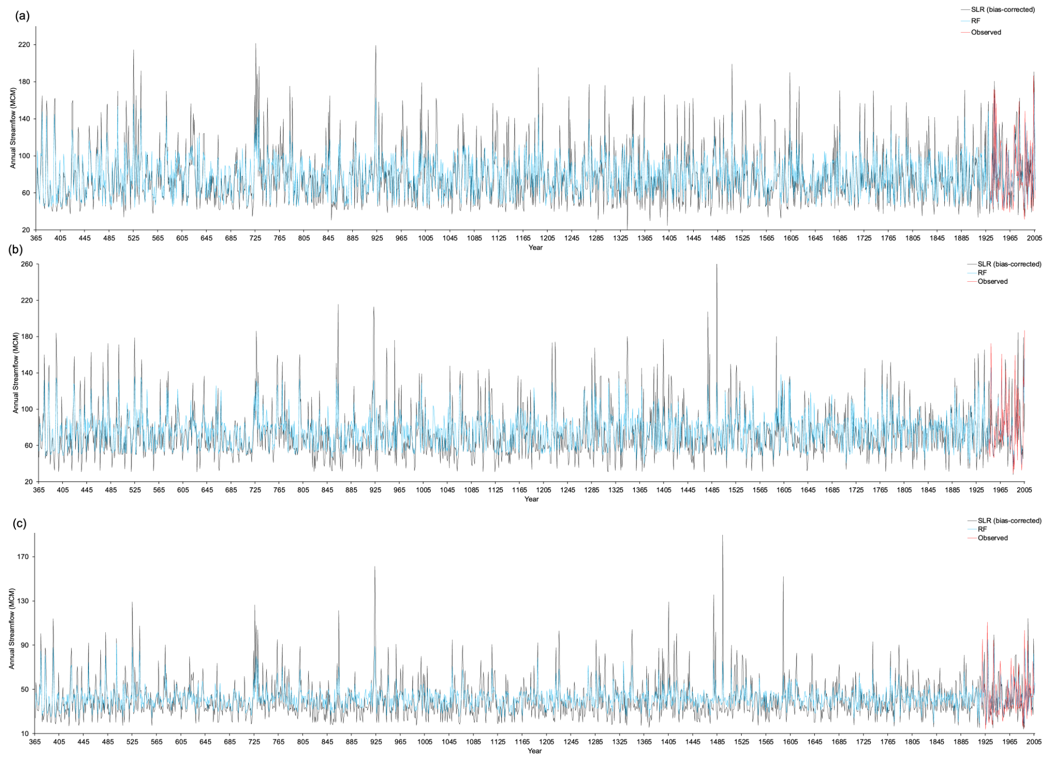
JJAS streamflow reconstructions (a) SF Holston Gauge, (b) Little TN Gauge, and (c) Valley Gauge – SLR vs RF from 365-2005 AD in the Tennessee River Valley.
Introduction
& Background
Use-Inspired Problem Statement
Material & Methods
Results
Discussion
Broader Impacts
Notes:
Mahsa

Slide 12
Analysis of Results
Machine learning methods, particularly Random Forest performed much better than traditional SLR methods
Performed best in summer months where tree growth is strongest and most rainfall
Introduction
& Background
Use-Inspired Problem Statement
Material & Methods
Results
Discussion
Broader Impacts
Notes:
Spencer

Slide 13
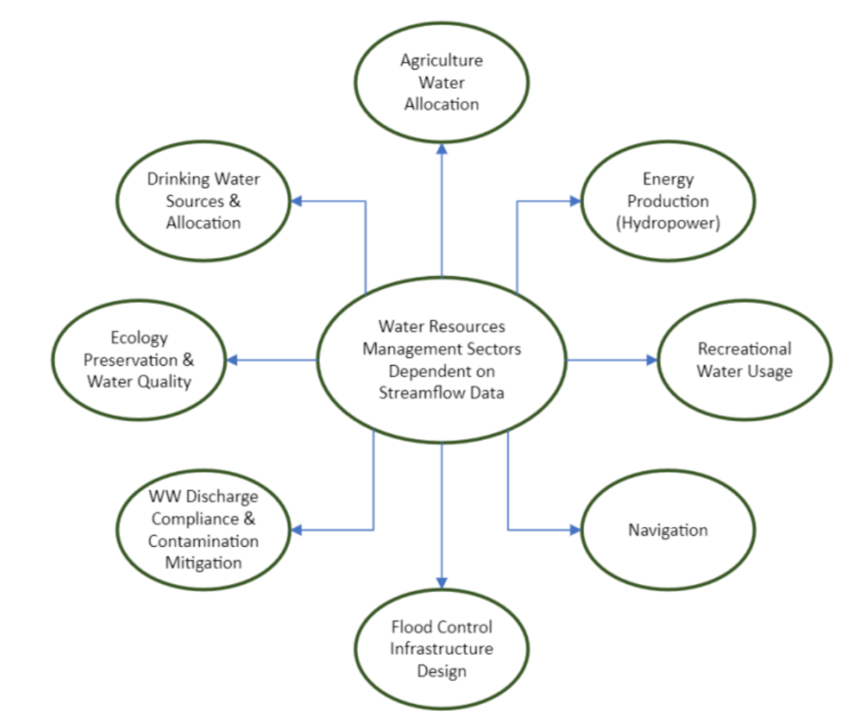
Streamflow reconstructions can be used to inform water resource management decisions by providing insights into past hydrological and climate conditions.
Stakeholders involved with this project, including Tennessee Valley Authority, will utilize this research to:
Have longer and more complete streamflow records within the Tennessee Valley
Better optimize water resource allocation and resilience planning
Evaluate the variability of water availability in a historical context
Utilize ML in summer streamflow reconstructions for highly skilled results as compared to regression based modeling
Introduction
& Background
Use-Inspired Problem Statement
Material & Methods
Results
Discussion
Broader Impacts
Notes:
Madi

Slide 14
Thank you!
Questions?

Slide 15
References
[1] Anderson, S.; Ogle, R.; Tootle, G.; Oubeidillah, A. Tree-Ring Reconstructions of Streamflow for the Tennessee Valley. Hydrology 2019, 6, 34. https://doi.org/10.3390/hydrology6020034
[2] Blasing, T.J.; Duvick, D.N.; West, D.C. Dendroclimatic calibration and verification using regionally averaged and single station precipitation data. Tree-Ring Bull. 1981, 41, 37–43.
[3] Edward R. Cook et al., Old World megadroughts and pluvials during the Common Era.Sci. Adv.1,e1500561(2015).DOI:10.1126/sciadv.1500561
[4] D.M. Meko, C.A. Woodhouse, K. Morino, Dendrochronology and links to streamflow, Journal of Hydrology, Volumes 412–413, 2012, Pages 200-209, ISSN 0022- 1694, https://doi.org/10.1016/j.jhydrol.2010.11.041
[5] Formetta, G.; Tootle, G.; Bertoldi, G. Streamflow Reconstructions Using Tree-Ring Based Paleo Proxies for the Upper Adige River Basin (Italy). Hydrology 2022, 9, 8. https://doi.org/10.3390/hydrology9010008
[6] Ho, M., Lall, U., and Cook, E. R. (2016), Can a paleodrought record be used to reconstruct streamflow?: A case study for the Missouri River Basin, Water Resour. Res., 52, 5195–5212, doi:10.1002/2015WR018444.
[7] Robeson, S. M., Maxwell, J. T., & Ficklin, D. L. (2020). Bias correction of paleoclimatic reconstructions: A new look at 1,200+ years of Upper Colorado River flow. Geophysical Research Letters, 47, e2019GL086689. https://doi.org/10.1029/2019GL086689
[8] Ramírez Molina, A. A., Bezak, N., Tootle, G., Wang, C., & Gong, J. (2023). Machine-Learning-Based Precipitation Reconstructions: A Study on Slovenia’s Sava River Basin. Hydrology, 10(11), 207.

